Slide 1
Aggregate G-Buffer Anti-Aliasing in Unreal Engine 4
Louis Bavoil (Developer Technology)
Cyril Crassin (Research)
Advances in Real-Time Rendering in Games course

Slide 2
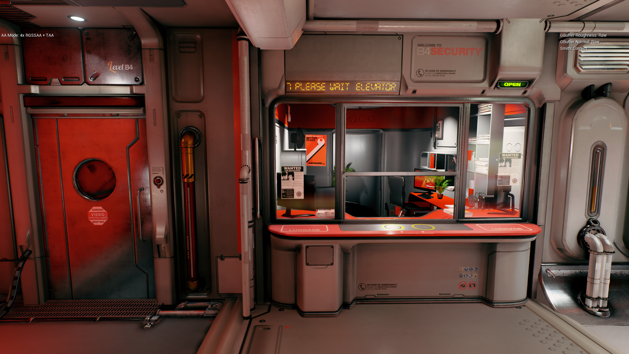
4x TAA = 4x SSAA with TAA
Scene courtesy of Quixel and Epic Games
Notes:
Currently in UE4, the best out-of-the-box experience you can get for anti-aliasing is by using “Temporal Anti-Aliasing”, applied on a super-sampled color buffer, typically rendered using 4x supersampling.
It’s the same for other major game engines. Supersampling plus TAA is an option which is exposed and already shipping in major AAA games from Frostbite, some UE4 titles and probably others.

Slide 3
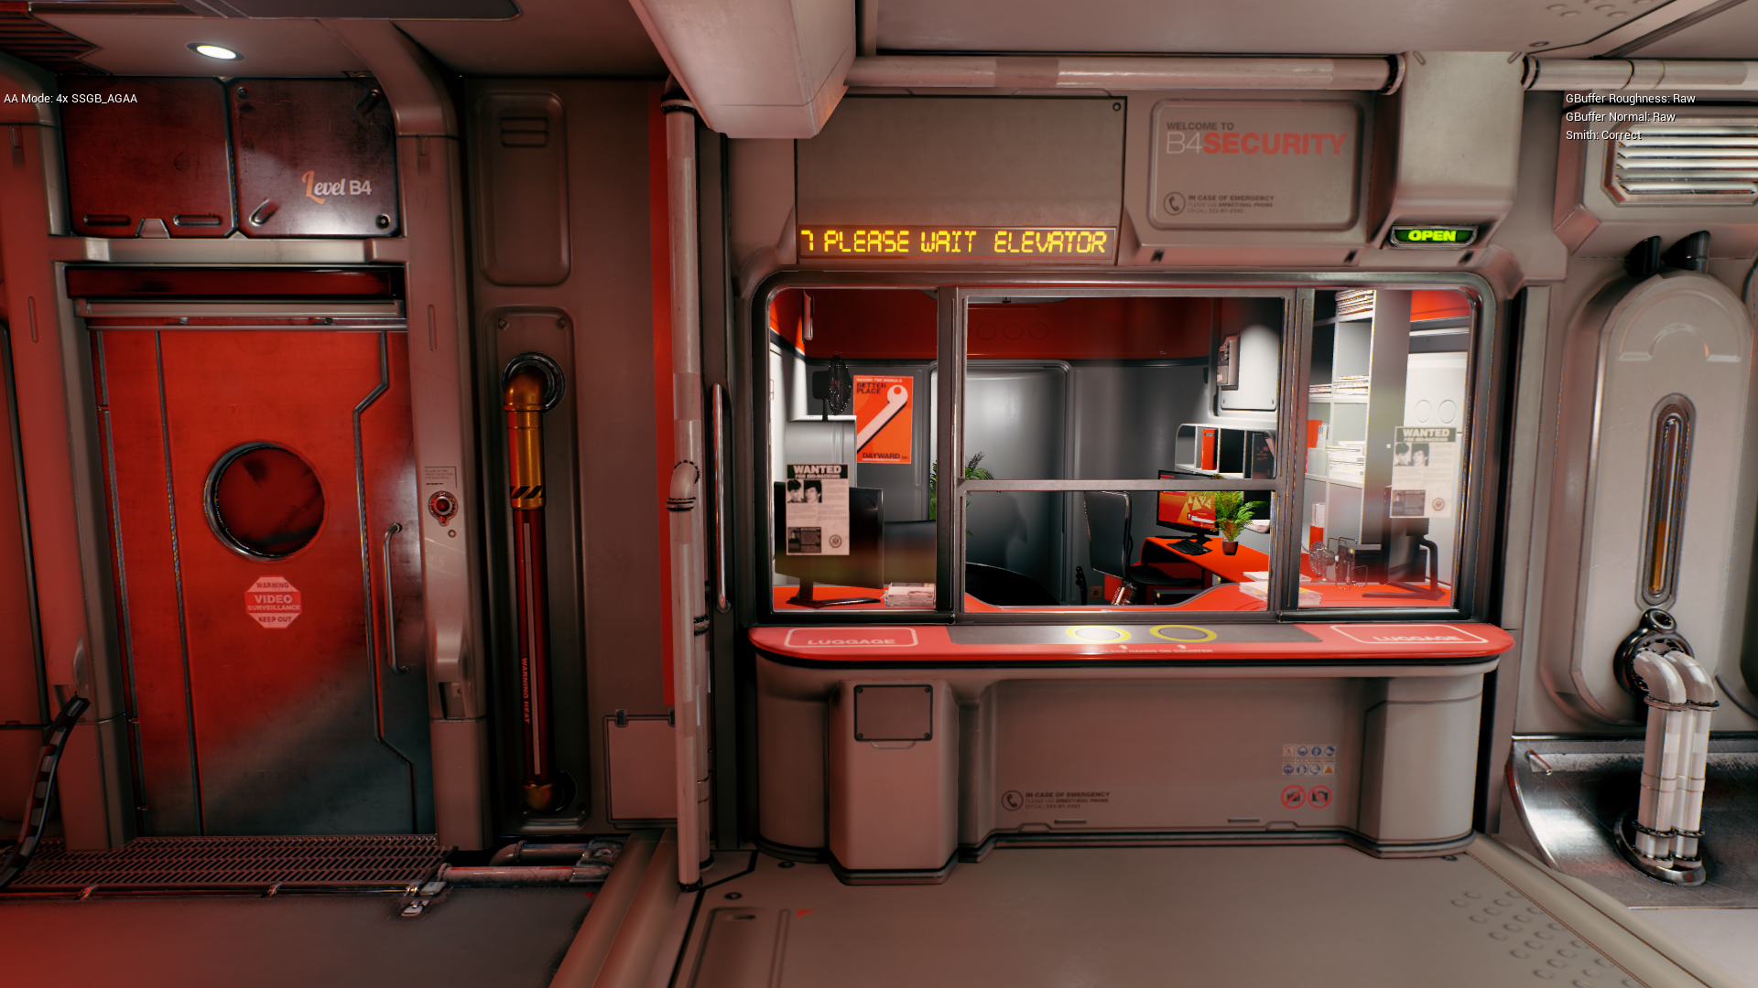
4xSSAA
Scene courtesy of Quixel and Epic Games
Notes:
This is the result we get doing only 4x SSAA, without TAA…

Slide 4
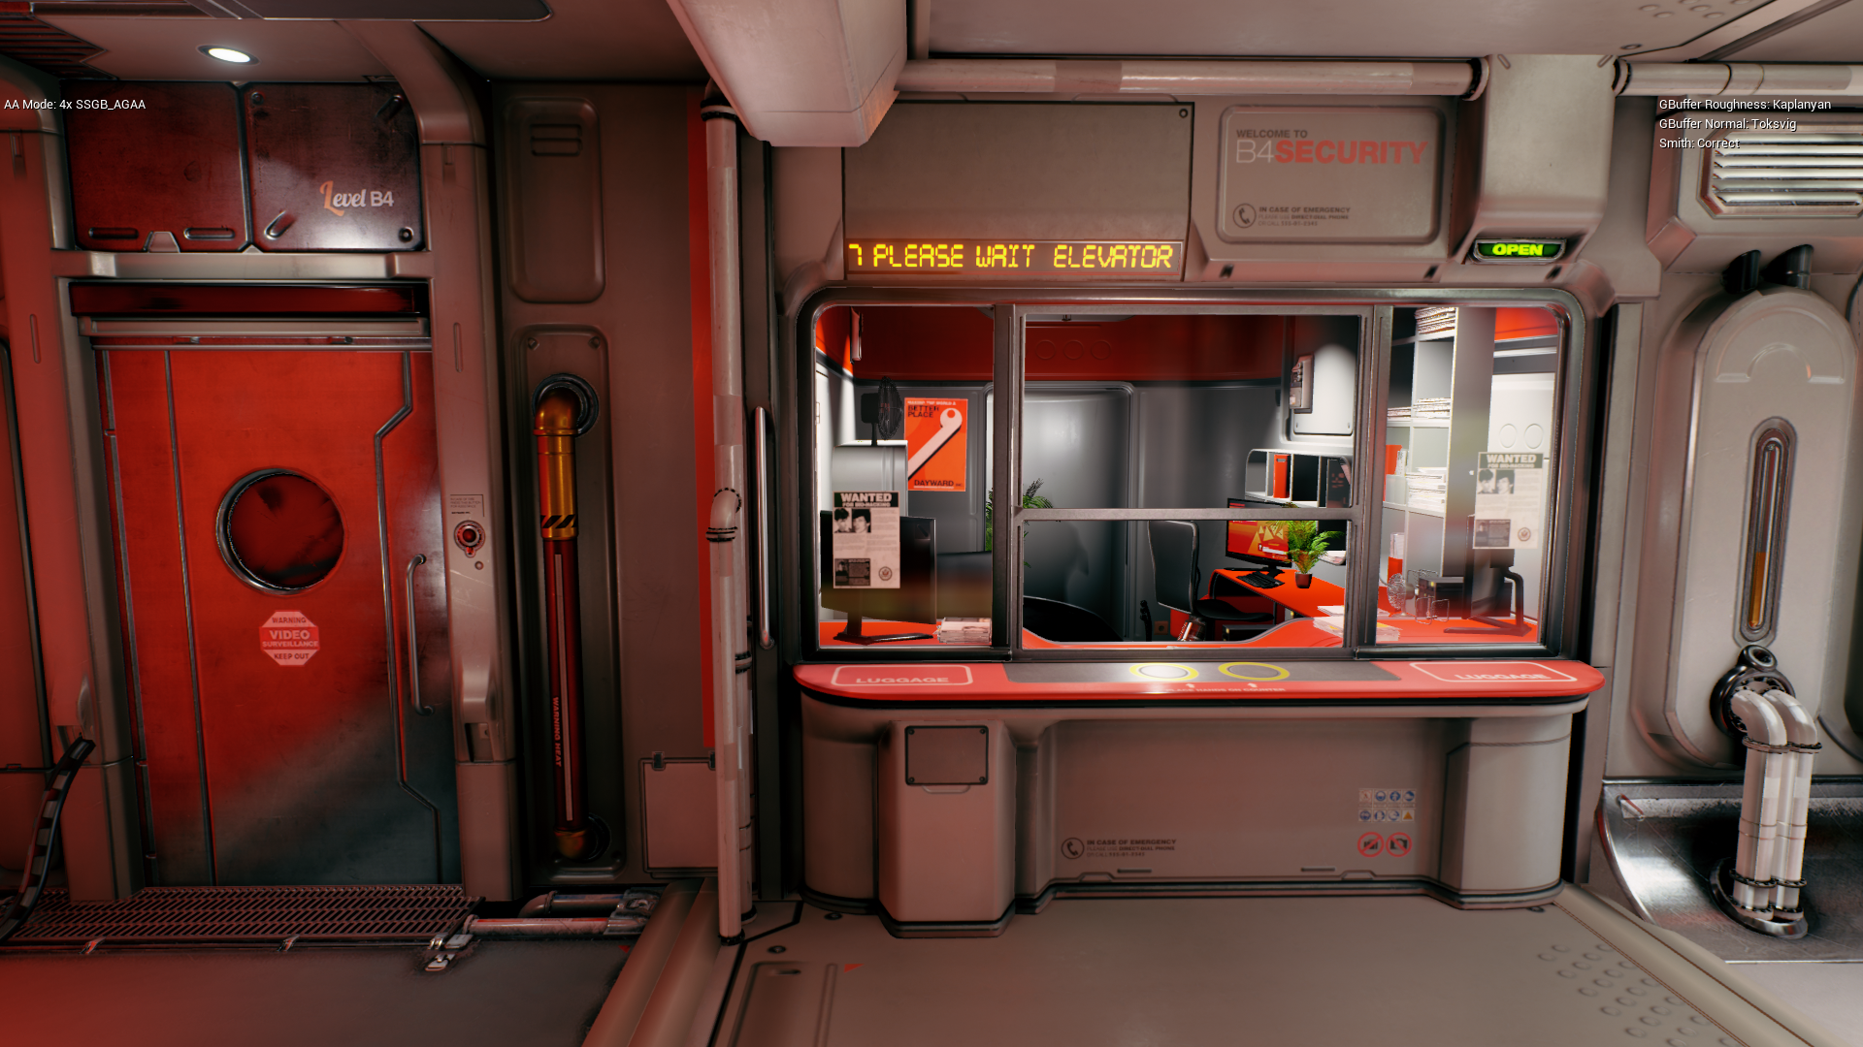
4xAGAA
Lighting: 4.7 -> 2.8 ms (1.7x faster)
Scene courtesy of Quixel and Epic Games
GPU times measured on GTX 1080 @ 1080p
Notes:
And this is also 4x SSAA, but running the lighting pass 1.7x faster using Aggregate G-Buffer Anti-Aliasing.

Slide 5
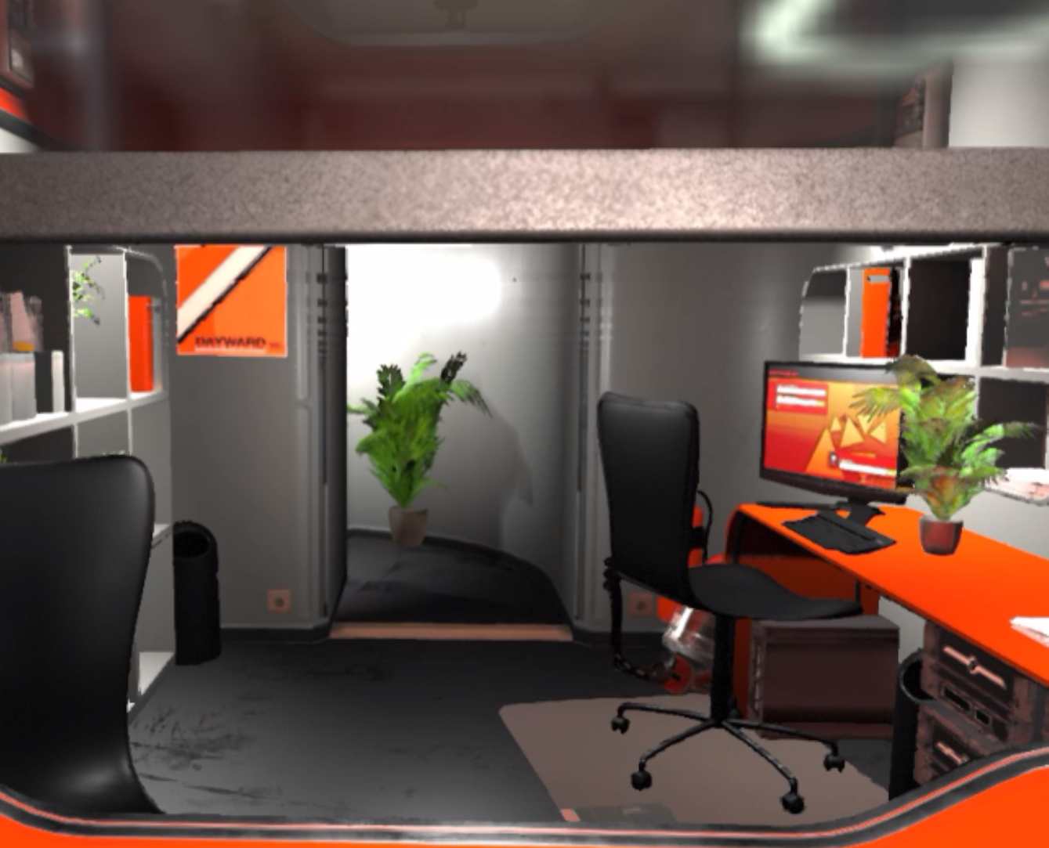
Temporal Anti-Aliasing
1x TAA
Great increase in AA quality [Karis 2014]
However:
Ghosting
Flickering
Over-smoothing visual features (Like specular highlights)
Needs combining with SSAA for best quality
Ghosting
Notes:
TAA is a massive improvement in anti-aliasing quality in games. However, there is some issues when used without super sampling:
There can be some ghosting, some flickering or some over-blurring of visual features.
In general, it greatly benefits from providing more screen-space and temporal coherence. That’s why it is usually combined with supersampling for best image quality.
The problem is that super-sampled rendering is quite costly….

Slide 6
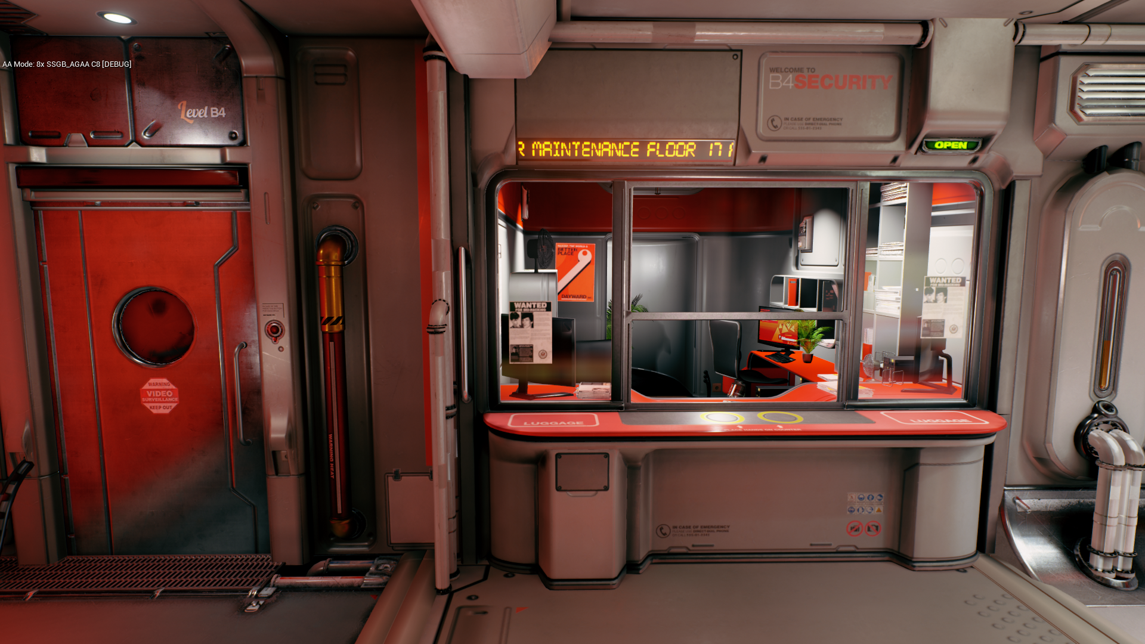
8xAGAA
Lighting: 9.4 -> 3.6 ms (2.6x faster)
Scene courtesy of Quixel and Epic Games
GPU times measured on GTX 1080 @ 1080p
Notes:
Given that AGAA makes supersampling less expensive, you can imagine pushing to higher sampling rates, maybe high enough that you can turn off TAA. In this example we do 8x AGAA without TAA. Running lighting 2.6x faster than 8x supersampling.
This gives us image quality close to 8x SSAA, at a similar cost to 4x SSAA.

Slide 7
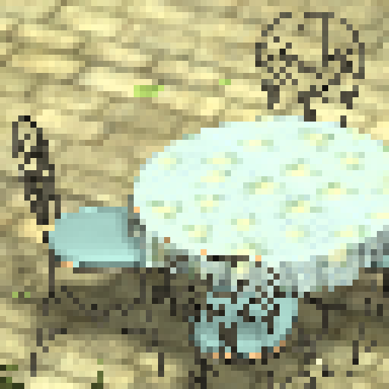
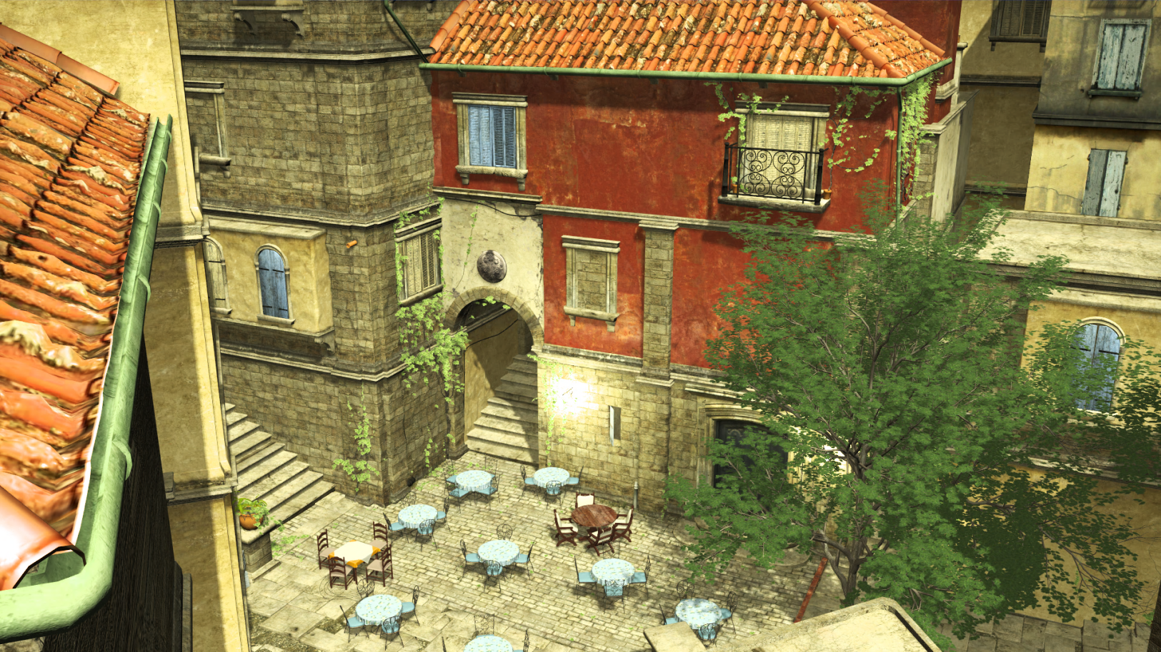
AGAA: Aggregate G-Buffer Anti-Aliasing
I3D 2015 + TVCG16
Cyril Crassin, Morgan McGuire, Kayvon Fatahalian, Aaron Lefohn
Single-sampled
8x Supersampling
2x AGAA
Decouples shading rate from the G-buffer sample count
Using dynamic pre-filtering
Rasterize at 4x or 8x MSAA/SSAA
Light at most 2x /pixel
Notes:
So last year at I3D we introduced AGAA. And there is now an extended version with more details we published at TVCG.
The high-level idea of this technique is to decouple the shading rate, from the geometry and materials sampling rates, in the context of deferred shading pipelines.
For that, we use some form of dynamic pre-filtering in screen-space.
This allows us to greatly reduce the cost of lighting.
What we want to do in this talk, it to give you an overview of the current state of our exploration around taking these research ideas into a game engine.
We will talk about some of the algorithmic changes, and the challenges we faced.

Slide 8
Pre-filtering, Supersampling, Post-filtering
Goal: Capturing or reproducing appearance of sub-pixel details
Various tools for filtering various geometric scales
Super-Sampled G-Buffer/Shading
Image-space
Super-Sampled visibility
Texture Maps Pre-Filtering
Image-space pre-filtering
SSAA (sample-rate)
FXAA/MLAA…
LIGHTING
Multi-Sampled G-Buffer/Shading
Image-space + Time
Geometric coverage + depth testing
MIP-mapping
AGAA
MSAA (fragment-rate)
TAA
Pre-filtering
Runtime sampling
Dynamic pre-filtering
Post-filtering
Notes:
Let’s take a step back and look at the most common options that we have for anti-aliased rendering in real-time applications:
Most simple: Supersampled rasterization (SSAA), and its optimization Multi-sampled rasterization (MSAA). MSAA allows capturing actual triangle details, with a maximum of 8 samples per-pixel on current GPUs.
Even when using supersampling, the number of samples that can be evaluated for each pixel is necessarily bounded, and higher-frequency details will not be captured and filtered properly. That’s why pre-filtering tools are also needed. Real-time renderers typically represent micro details in texture-maps instead of actual geometry, and those maps are pre-filtered using MIP-mapping.
Finally, post-filtering techniques operate post-lighting, on the final shaded color values of the pixels/samples, and reconstruct or hallucinate sub-pixel details by taking advantage of spatial coherence with neighboring pixels (for FXAA/MLAA…), or also temporal coherence by re-projecting samples from previous-frames.
All those tools are generally combined in order to obtain the best possible quality within a given time budget.
AGAA proposes a new kind of pre-filtering in the context of deferred shading pipelines, which is performed in image-space and computed on the fly from dynamically sampled shading attributed.

Slide 9
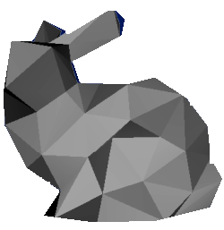
AGAA Pipeline: (Very) High-Level View
What about pre-filtered shading ?
SSAA/MSAA Raster
Pre-filtering
Lighting
Super-sampled G-Buffer
Per-aggregate averaged surface + shading attributes
Final shaded pixel color
Notes:
Now, let’ see how AGAA works in UE4:
# The starting point of AGAA is a supersampled G-buffer, which uses the exact same layout as the standard UE4 G-buffer.
# Then, instead of shading each sub-sample individually, as we would normally do, we combine those sub-samples together inside what we call the “aggregates”. The aggregates contain pre-filtered shading attributes averaged from the sample values. From our experience, using two aggregates is generally enough with up to 8x MSAA.
# Finally, after generating the aggregates, we will light each of them once, regardless of what rate we sampled the g-buffer at.
# Before digging a little bit more inside the details of this pipeline, let’s take a look at the pre-filtering.

Slide 10
Lighting Pre-Filtered Aggregates
Goal: Approximate average reflectance over an aggregate’s footprint
Independently pre-filtering the inputs of the shading function for each aggregate
Inspired by texture-space and voxel-space pre-filtering schemes
Attributes decorrelation assumption
Far-field assumption
Per-aggregate statistical information:
Average most shading parameters
Build a Normal Distribution Function (NDF)
Average attenuation from shadowing
Far-field assumption
Image courtesy of Kaplanyan2016
Notes:
The goal of the pre-filtering scheme is to allow approximating the average reflectance over the footprint of an aggregate, by linearly and independently pre-filtering all the inputs of the shading function.
For that, we take inspiration from texture-space and voxel-space pre-filtering schemes for analytic microfacet BRDFs.
In practice, we average most of the shading parameters, and we build a normal distribution function used to filter the microfacet BRDF model.
Among other details, it’s interesting to note here that we also pre-filter shadowing from UE’s attenuation buffer.

Slide 11
Standard UE4 Shading Model
Restricted our investigation to the “Standard” shading model:
Diffuse BRDF: Lambertian
Specular BRDF: GGX/Trowbridge-Reitz
Pre-filtering schemes for GGX:
[Toksvig 2005]: Isotropic NDF, but cheap Converting Phong specular exponent to Roughness
SGGX [Heitz 2015] (Spherical GGX): Anisotropic NDF Represented as an ellipsoid, works on full spherical domain
Lambertian: Analytic approx. using Toksvig
[Baker and Hill 2012]
Notes:
So far, we have focused only on pre-filtering the “standard” shading model in UE4. It s based on a simple Lambertian diffuse BRDF, and a GGX specular BRDF.
The specular GGX BRDF is the most important one to filter. For that, we experimented both with Toksvig, which only encodes an isotropic variance.
SGGX generalizes the GGX definition and allows encoding microfacets spread spatially, and encodes anisotropic variance.
We have also experimented with the Lambertian analytic approximation from [Baker and Hill 2012] and found that it made subtle differences on certain diffuse objects, and almost made no visual difference on the SciFiHallway scene. All our results in this presentation were generated without it.

Slide 12
AGAA Pipeline: (Very) High-Level View
How are aggregate created ?
Pre-filtering
Per-aggregate averaged surface + shading attributes

Slide 13
Aggregate Creation: Clustering
Pixel frustum
Pixel frustum
Pixel frustum
Goal: Minimize shading errors due to correlated attributes [Bruneton and Neyret 2012] Distance metric:
Shading Model
Normal
Depth/Position
Aggregate 1
Clustering samples:
Cross-primitives + Disjoint surfaces
Aggregate 0
Pixel
Pixel
1: MSAA/SSAA G-Buffer Rasterization
2: Clustering
Notes:
This diagram gives an example of some visible geometry within the frustum of a given pixel.
# Once we have generated the full supersampled g-buffer, the first step is to associate each sub-sample to one of the two aggregates.
# We use a clustering pass for that.
In contrast to texture-space pre-filtering schemes, aggregates can contain samples from totally different surfaces that can be spread spatially.
What we want to do here with the clustering is basically to optimize the quality of the pre-filtering, and minimize the shading errors.
The first important thing is to separate samples with different shading models, given that pre-filtered shading schemes assume a unique shading model per-aggregate.
Then, we built a simple distance metric which maximizes spatial locality while avoiding aggregating together very divergent normal directions.

Slide 14
Aggregate Creation: Aggregation
Pixel frustum
Pixel frustum
Pixel frustum
Pixel frustum
Aggregate 1
Aggregate 1
Aggregate 0
Aggregate 0
Pixel
Pixel
Pixel
1: MSAA/SSAA G-Buffer Rasterization
2: Clustering
3: Aggregation Pre-filtering
Notes:
# Once we have this sample to aggregate mapping, the remaining step is to actually performs the filtering of the shading attributes per-aggregate,
# using the data from the super-sampled G-buffer.
To recap, we average most of the shading attributes, and we transform the per-sample normal and roughness information into the Normal Distribution representation associated to our BRDF model, which allows us to linearly combine them, and approximate their variance over an aggregate’s footprint.

Slide 15
Aggregate Creation
Implemented in the
tiled-deferred shading pass
Pixel frustum
Pixel frustum
Pixel frustum
Pixel frustum
Aggregate 1
Aggregate 1
Aggregate 0
Aggregate 0
Pixel
Pixel
Pixel
1: MSAA/SSAA G-Buffer Rasterization
2: Clustering
3: Aggregation Pre-filtering
Notes:
In UE4, there are multiple possible render paths to perform shading. One of them is Tiled Deferred shading.
We have configured the engine to use the Tiled Deferred path whenever possible and implemented the AGAA aggregation and lighting in the Tiled Deferred Shading compute shader.
For getting best performance, we have implemented the G-Buffer aggregation step at the beginning of the shading phase of this compute shader, which lets us re-use the aggregated attributes for all processed lights for the current tile.

Slide 16
Metadata
1x/pixel
G-Buffer
8xAA or 4xAA
1: Clustering
SampleToAggregate Mappping
Shading Model ID
Depth
Aggregate Attributes
Normal
2x/pixel
BaseColor (Albedo)
Shading Model ID
Metallic
Specular
Normal Distrib. (NDF)
Roughness
Avg WS Position
Emissive
Avg DiffuseColor
…
Avg SpecularColor
2: Aggregation
…
Pixel
[8x Samples]
Pre-filtering
Pixel
[2x Aggregates]
Notes:
The clustering pass fetches all of the ShadingModel ID, depths and normals for each pixel and computes the mapping from sample ID to aggregate ID. Because there are only 2 aggregates per pixel, the per-sample aggregate IDs can be stored with one bit per sample. We store these bits in a R16_UINT render target.
We also store the per-aggregate ShadingModel IDs in the same render target.
Next for each GBuffer sample, we reconstruct the shading parameters (in the format used for aggregate shading) based on the GBuffer data.
And we average these shading parameters across all samples within each aggregate.
There is one exception though: for the world-space positions, we have found that it is much faster to first calculate the average view-space depth per aggregate, and then reconstruct a world-space position by assuming that the screen-space XY coordinate for this position is at the pixel center.
This approximation does not introduce any visible artifacts in our tests.

Slide 17
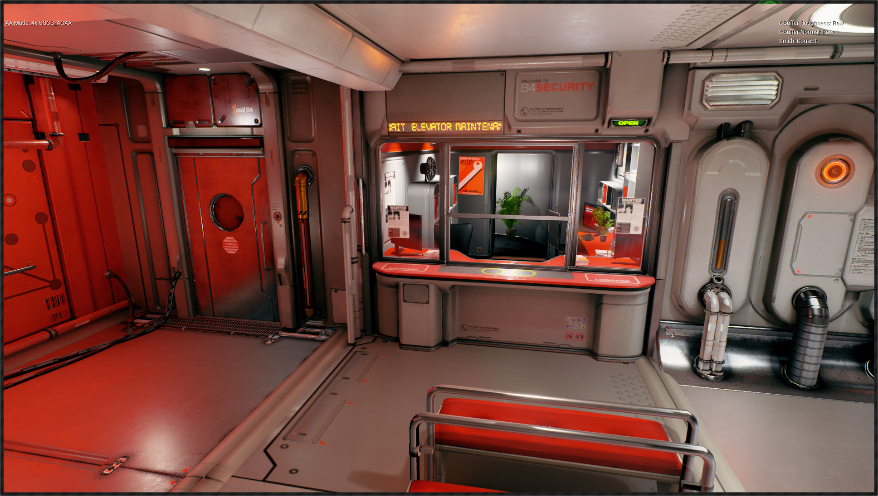
4xAGAA
Artifacts with no G-Buffer sample NDF pre-filtering
Non-normal mapped mesh with high geometric curvature
Normal-map details
Scene courtesy of Quixel and Epic Games
Notes:
After doing all that, we were still seeing aliasing & flickering on specular highlights on certain objects:
The door on this screenshot is a flat surface, and there was aliasing on the bumps from the normal map
The vertical chrome pipe also had aliasing artifacts
At this point, we realized that we were just using a super-sampled GBuffer but not doing any NDF pre-filtering at the GBuffer sample level.

Slide 18
AGAA Pipeline: (Very) High-Level View
High-quality sample
Supersampled G-Buffer
Notes:
# In addition to pre-filtering the shading attributes at the scale of the aggregates, AGAA also needs sample values to be filtered as best as possible

Slide 19
Pre-Filtering G-Buffer Samples
[Toksvig 2005] normal-map pre-filtering
[Kaplanyan 2016] filtering geometric curvature
Notes:
When fetching the normal of a given GBuffer sample, we want to be able to not only fetch a normal vector, but also reconstruct some information on its variance.
We use Toksvig normal-map pre-filtering, assuming that the material fetches a single normal map and plugs it directly into the GBuffer.
We will see later that material graphs can be arbitrarily complex.
In addition, we also filter the geometric curvature, coming from the actual triangle mesh, using Kaplanyan’s analytic algorithm which operates during geometry rendering.

Slide 20
Kaplanyan’s Curvature Filtering
float3 GetAgaaAverageQuadNormal(FMaterialPixelParameters MaterialParameters, float3 N)
{
int2 PixelPos = MaterialParameters.SVPosition.xy;
N -= ddx_fine(N) * (float(PixelPos.x & 1) - 0.5);
N -= ddy_fine(N) * (float(PixelPos.y & 1) - 0.5);
return N;
}
Notes:
The first step of the algorithm calculates the average normal for the current 2x2 pixel quad in the Gbuffer Fill pass.
This is done using ddx/ddy instructions on the geometric normal (with no normal maps applied).

Slide 21
float2 GetAgaaKaplanyanFilteringRect(FMaterialPixelParameters MaterialParameters)
{
// Shading frame
float3 T = MaterialParameters.TangentToWorld[0];
float3 ShFrameN = normalize(MaterialParameters.TangentToWorld[2]);
float3 ShFrameS = normalize(T - ShFrameN * dot(ShFrameN, T));
float3 ShFrameT = cross(ShFrameN, ShFrameS);
// Use average quad normal as a half vector
float3 hppW = GetAgaaAverageQuadNormal(MaterialParameters, ShFrameN);
// Compute half vector in parallel plane
hppW /= dot(ShFrameN, hppW);
float2 hpp = float2(dot(hppW, ShFrameS), dot(hppW, ShFrameT));
// Compute filtering region
float2 rectFp = (abs(ddx_fine(hpp)) + abs(ddy_fine(hpp))) * 0.5f;
// For grazing angles where the first-order footprint goes to very high values
rectFp = min(View.AgaaKaplanyanRoughnessMaxFootprint, rectFp);
return rectFp;
}
Notes:
This average pixel-quad normal is then used together with the normal of the current fragment to estimate curvature variance information.

Slide 22
Kaplanyan’s Curvature Filtering
float GetAgaaKaplanyanRoughness(FMaterialPixelParameters MaterialParameters, float InRoughness)
{
float2 rectFp = GetAgaaKaplanyanFilteringRect(MaterialParameters);
// Covariance matrix of pixel filter's Gaussian (remapped in roughness units)
// Need to x2 because roughness = sqrt(2) * pixel_sigma_hpp
float2 covMx = rectFp * rectFp * 2.f * View.AgaaKaplanyanRoughnessBoost;
// Since we have an isotropic roughness to output, we conservatively take the largest edge of the filtering rectangle
float maxIsoFp = max(covMx.x, covMx.y);
return sqrt(InRoughness * InRoughness + maxIsoFp); // Beckmann proxy convolution for GGX
}
Notes:
Finally, the curvature variance information is converted to an isotropic roughness bias and the original roughness is modified.
So regions that have a high curvature get an increased roughness, which removes specular shading aliasing.
For the record, we use:
AgaaKaplanyanRoughnessMaxFootprint=0.3
AgaaKaplanyanRoughnessBoost=2.0

Slide 23
4xAGAA
G-Buffer NDF PreFiltering=OFF
Scene courtesy of Quixel and Epic Games

Slide 24
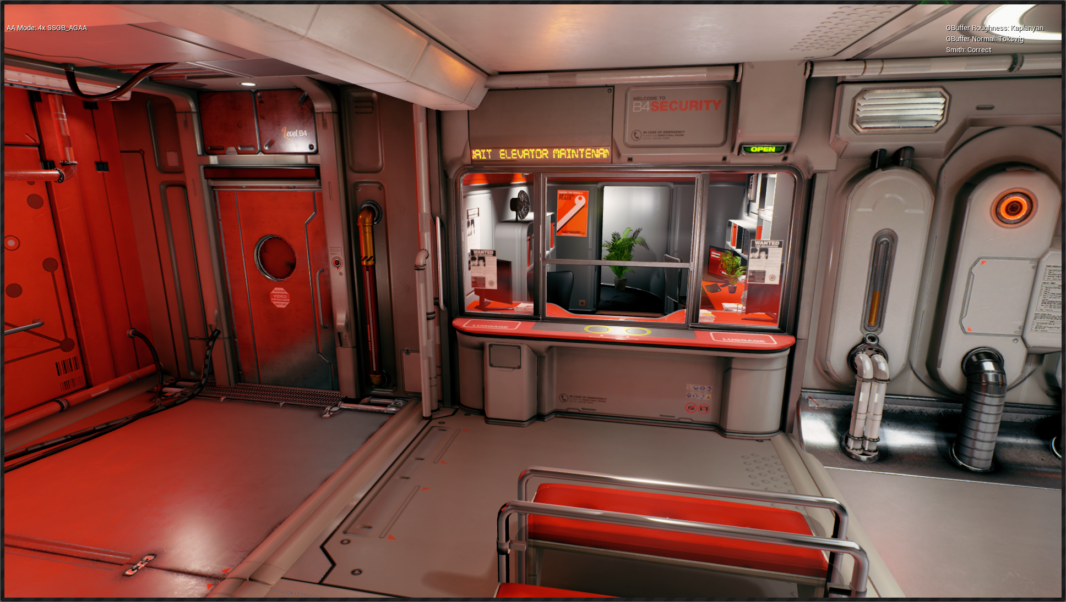
4xAGAA
G-Buffer NDF PreFiltering=ON
Scene courtesy of Quixel and Epic Games
Notes:
By adding Toksvig’s and Kaplanyan’s pre-filtering methods to the screen-space pre-filtering of AGAA, we were able to get rid of the specular shading aliasing artifacts in this scene.

Slide 25
VRAM Overhead for 4xAGAA
AGAA Pass | Render Target | Video Memory Bytes
AGAA Clustering | AGAA MetaData | WxHx1 R16_UINT
AGAA Lighting & Reflections | Per-Aggregate Lit Colors | WxHx2 R11G11B10F
Merge Emissive | Per-Pixel Lit Color + Emissive | WxHx4 R11G11B10F
 |  | Total VRAM overhead: 26 bytes / pixel
Notes:
Let’s recap the passes of our AGAA implementation and their impact on video memory usage.
During lighting we light the 2 aggregates in the same pass, which produces 2 R11G11B10F colors per pixel.
We then merge the per-sample emissive colors with the per-aggregate non-emissive lit colors, and write the per-sample results in a super-sampled color buffer.
Translucency passes & post processing passes are then performed with super-sampling (could also be MSAA).

Slide 26
Resolve
Emissive kept per-sample
Always resolving tone-mapped colors [Karis2014]
Notes:
To avoid HDR firefly artifacts, it is important to:
- keep the HDR emissive colors per-sample (do not include the emissive in the per-aggregate lit colors)
- perform the final Resolve (average of the per-sample colors) on tone-mapped colors.

Slide 27
Results
Image quality and performance

Slide 28
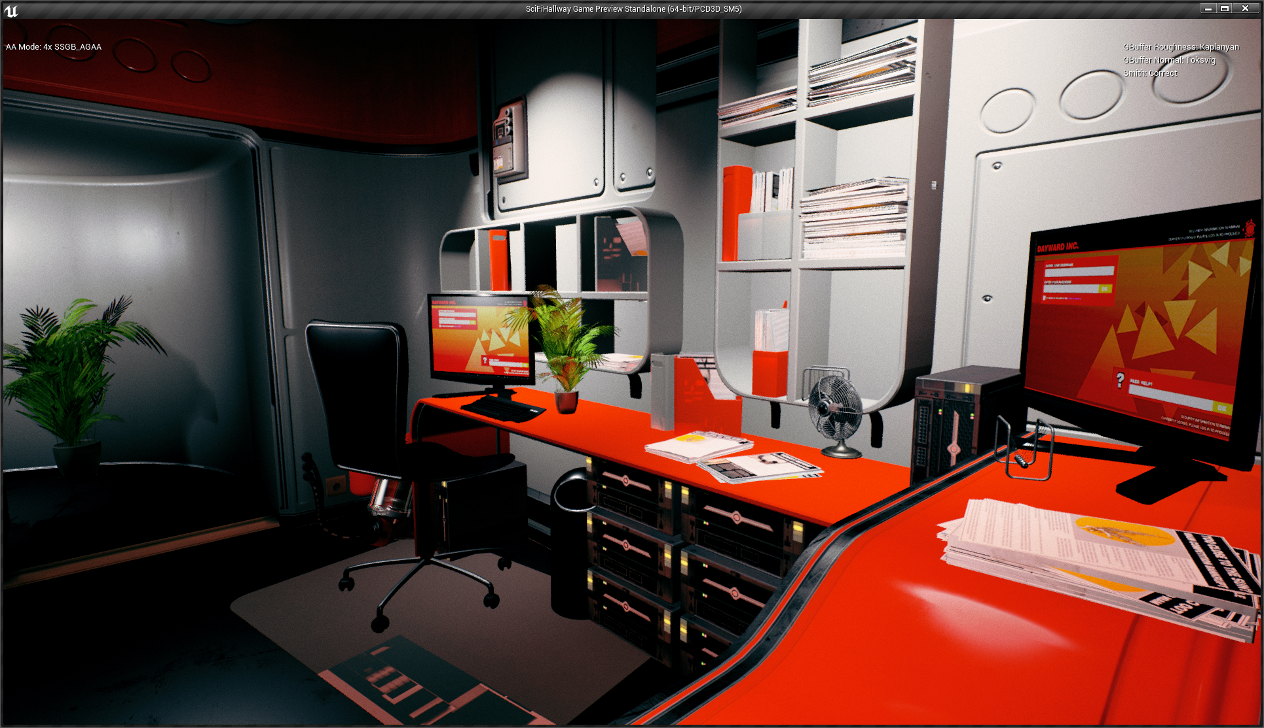
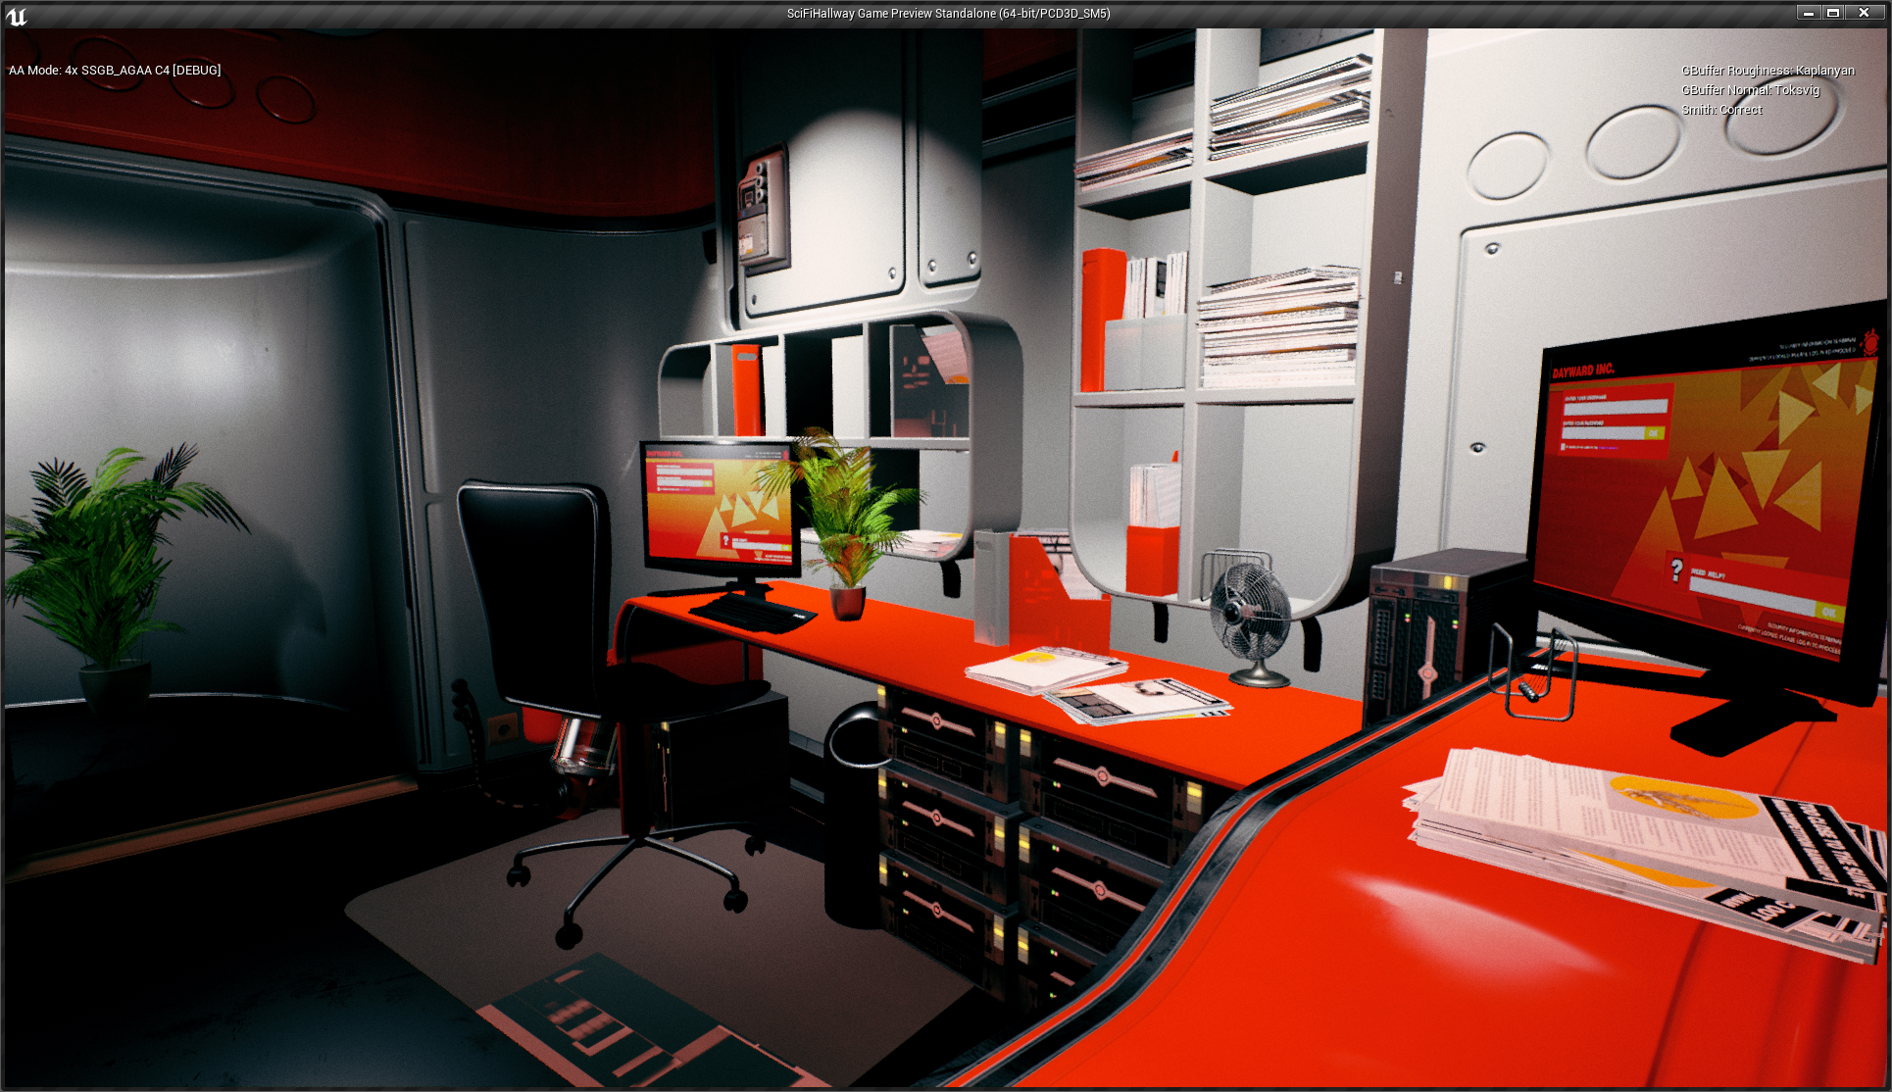
4x AGAA
4xSSAA
Scene courtesy of Quixel and Epic Games

Slide 29
4x AGAA
4xAGAA
Scene courtesy of Quixel and Epic Games

Slide 30
4xTAA
Scene courtesy of Epic Games

Slide 31
4xAGAA
Scene courtesy of Epic Games

Slide 32
4xSSAA
Scene courtesy of Epic Games

Slide 33
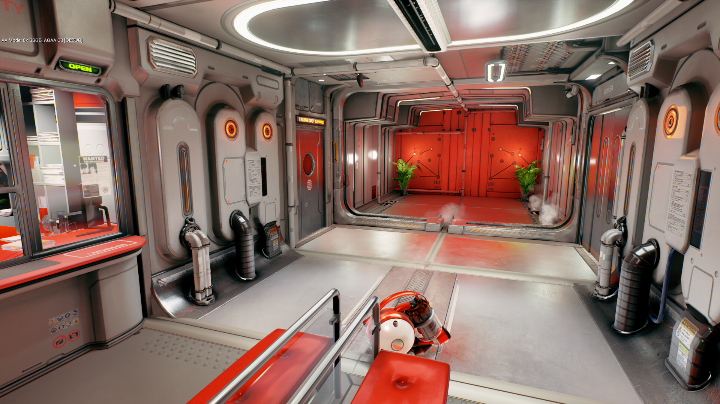
4x AGAA
8xSSAA
Scene courtesy of Quixel and Epic Games

Slide 34
4x AGAA
8xAGAA
Scene courtesy of Quixel and Epic Games

Slide 35
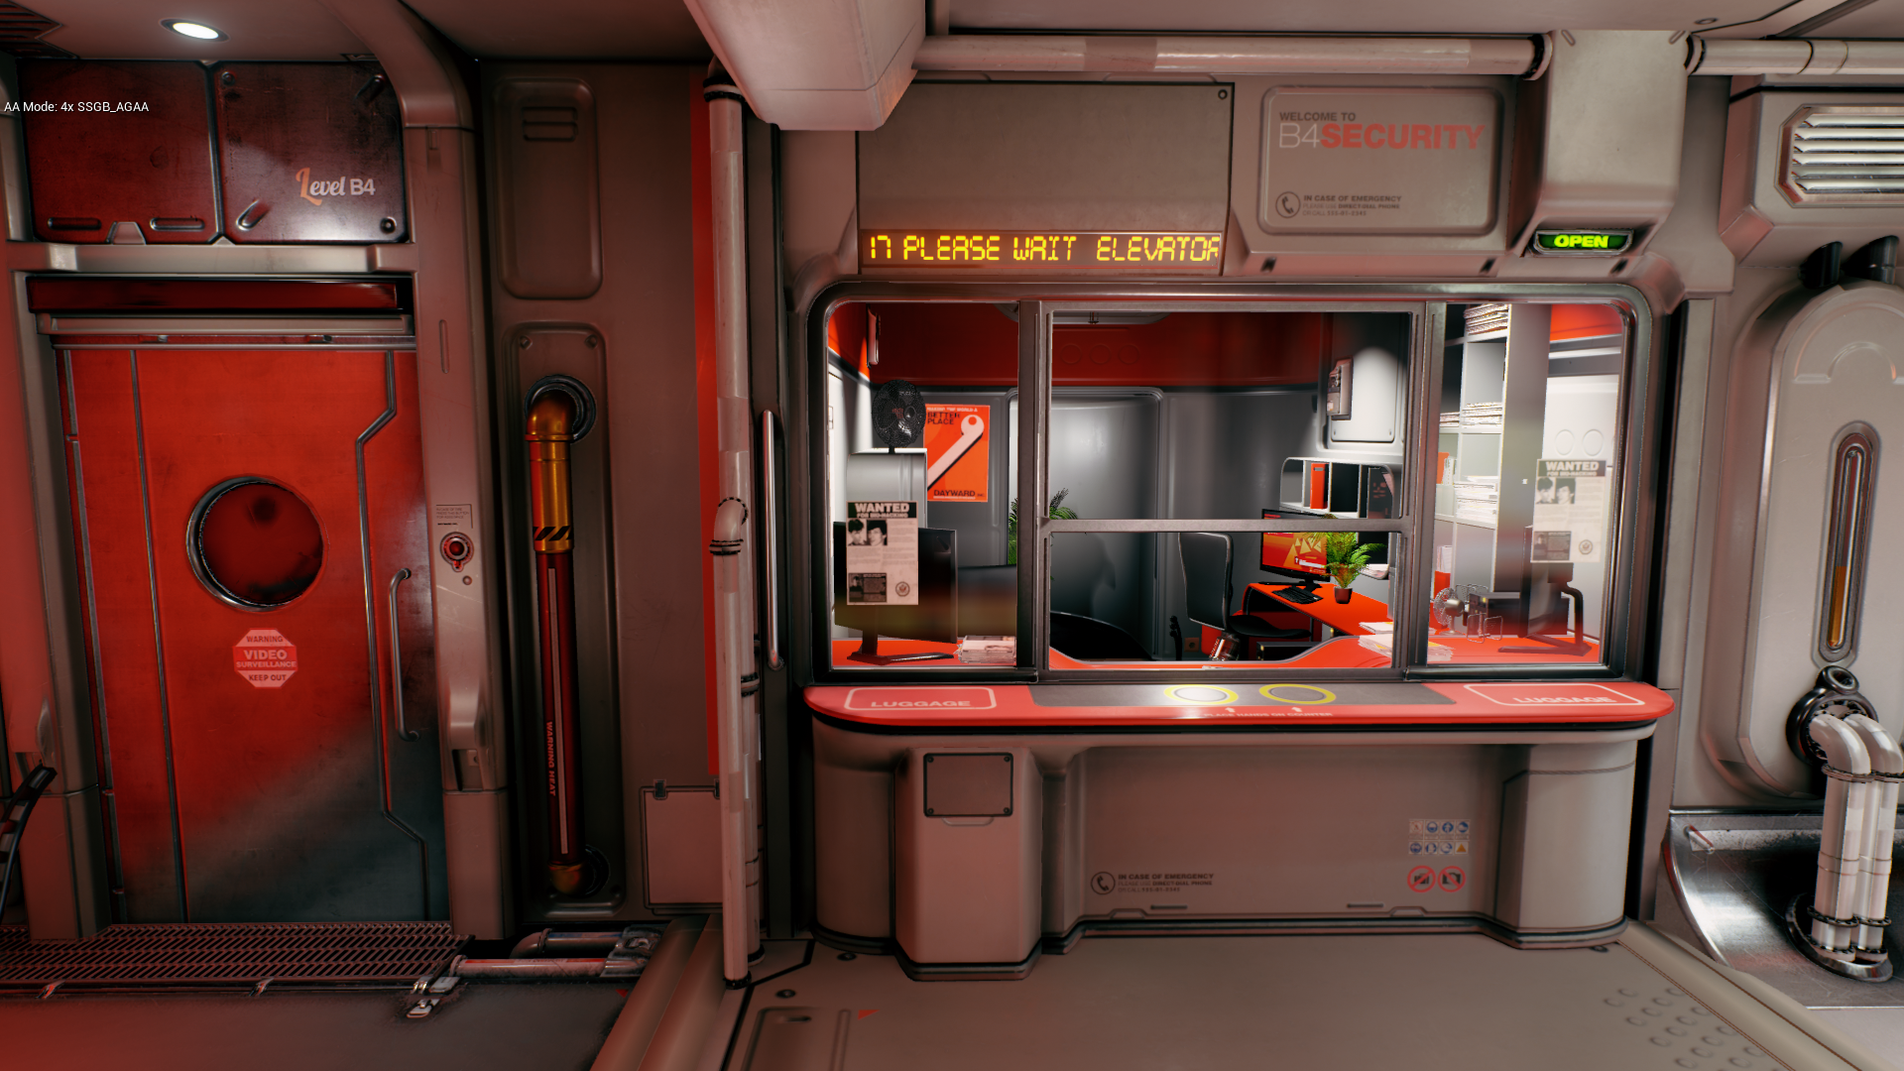
Disabling ReflectionEnvironment (this pass is not optimized yet)…
ReflectionEnvironment=ON
Scene courtesy of Quixel and Epic Games

Slide 36
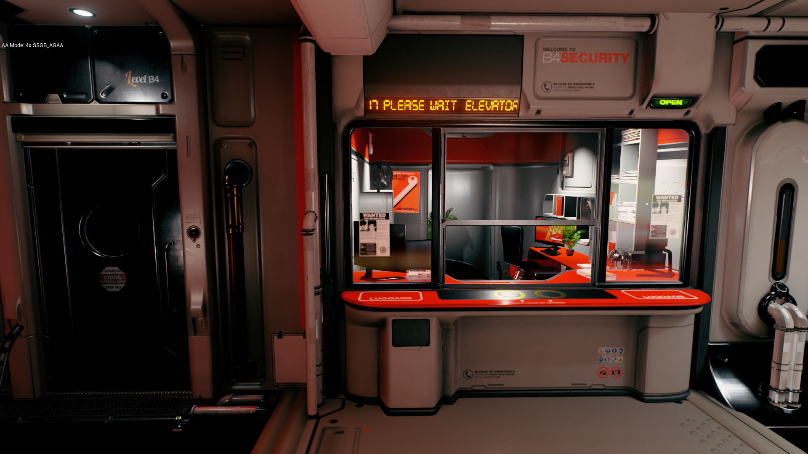
ReflectionEnvironment=OFF
Scene courtesy of Quixel and Epic Games

Slide 37
4xAGAA Performance
GPU Time (ms) | 4xSSAA | 4xAGAA | 4xAGAA/4xSSAA
Z PrePass | 0.13 | 0.13 | 1.0x
GBuffer Fill | 1.26 | 1.26 | 1.0x
Lighting | 4.71 | 2.85 | 1.65x
PostProcessing | 0.55 | 0.55 | 1.0x
Frame | 6.65 | 4.79 | 1.39x
GPU times measured in 1080p on GTX 1080 (8GB) @ 1607 Mhz
Using the accurate Vis_Smith function (not Vis_SmithJointApprox)

Slide 38
MSAA
The cost of better performance

Slide 39
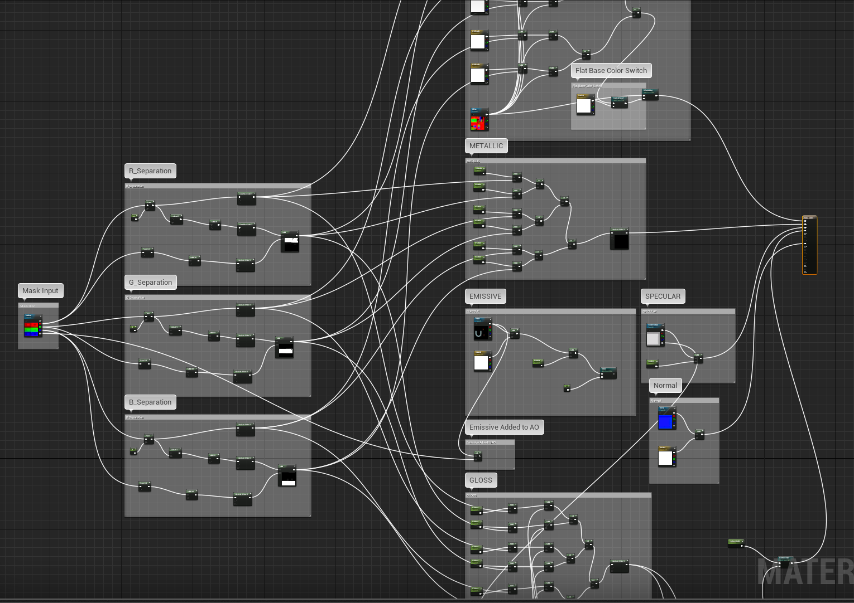
Why not MSAA ? Complex material graphs
Artist-controlled material definitions
Non-linear operations
Needs to be supersampled
Notes:
The reason is that the shading function needs to be super-sampled.
Even though UE4 mostly relies on texture maps for storing material’s input parameters, which can be pre-filtered,
artists control the material definitions using potentially complex material graphs like this one.
Those graphs can contain lots of non-linear operations, such as discard calls, power functions, clamps, masks, conditions, and various combinations of those, which breaks texture-space pre-filtering.

Slide 40
Making MSAA More Feasible
Using MSAA in the GBuffer fill can produce great performance boosts (~2x) over super-sampling
However, per-fragment shading can introduce artifacts if the pixel shader is using discard or non-linear maths
Proposed solution:
1. Encourage artists to avoid non-linear material nodes (pow, clamp, …)
2. Selectively super-sample the GBuffer attributes that have nonlinearities
Notes:
A solution would be to selectively super-sampler certain GBuffer attributes automatically based on a static analysis of the material graph.
We think that MSAA could still be used if artists were made aware that using masked materials and/or non-linear material nodes can slow down performance due to the incurred super-sampling at runtime.

Slide 41
Limitations
AGAA is speeding up only the lighting pass
Non-standard UE shading models not fully tested yet
More than 2 shading model IDs / pixel untested
Notes:
Although the original paper proposed a solution to speedup the Gbuffer Fill using Maxwell features, it raises more issues in the context of UE4 and we decided not to do it.
Tiled-deferred shading is the only light pass that is optimized so far in our UE4 implementation.

Slide 42
Conclusion
AGAA speeds up super-sampled lighting
4x AGAA lighting is 1.7x faster than 4x SSAA
8x AGAA lighting is 2.6x faster than 8x SSAA
Can be combined with TAA or used alone
Still ongoing work

Slide 43
Thanks
Natalya Tatarchuk
Aaron Lefohn
Jon Jansen
Anton Kaplanyan

Slide 44
Questions?

Slide 45
References
[TVCG 2016] Cyril Crassin, Morgan McGuire, Kayvon Fatahalian, Aaron Lefohn, "Aggregate G-Buffer Anti-Aliasing - Extended Version", TVCG, 2016. http://research.nvidia.com/sites/default/files/publications/AGAA_Extended_TVCG2016_AuthorsVersion.pdf
[Kaplanyan 2016] A. Kaplanyan, S. Hill, A. Patney & A. Lefohn, “Filtering Distributions of Normals for Shading”, HPG 2016.
[Heitz 2015] Eric Heitz, Jonathan Dupuy, Cyril Crassin and Carsten Dachsbacher, “The SGGX Microflake Distribution“, SIGGRAPH 2015.
[I3D 2015] Cyril Crassin, Morgan McGuire, Kayvon Fatahalian, Aaron Lefohn, "Aggregate G-Buffer Anti-Aliasing“, I3D, 2015.
[Karis 2014] Brian Karis (Epic), “High-Quality Temporal Super-Sampling”, SIGGRAPH 2014.
[Baker and Hill 2012] Stephen Hill (Ubisoft) & Dan Baker (Firaxis), “Rock-Solid Shading: Image Stability without Sacrificing Detail”, GDC 2012.
[Bruneton and Neyret 2012] Bruneton & Neyret, “A Survey of Non-linear Pre-filtering Methods for Efficient and Accurate Surface Shading”, TVCG 2011.
[Toksvig 2005] Toksvig, “Mipmapping normal maps”, Journal of Graphics Tools 10, 2005.

